Slide 1
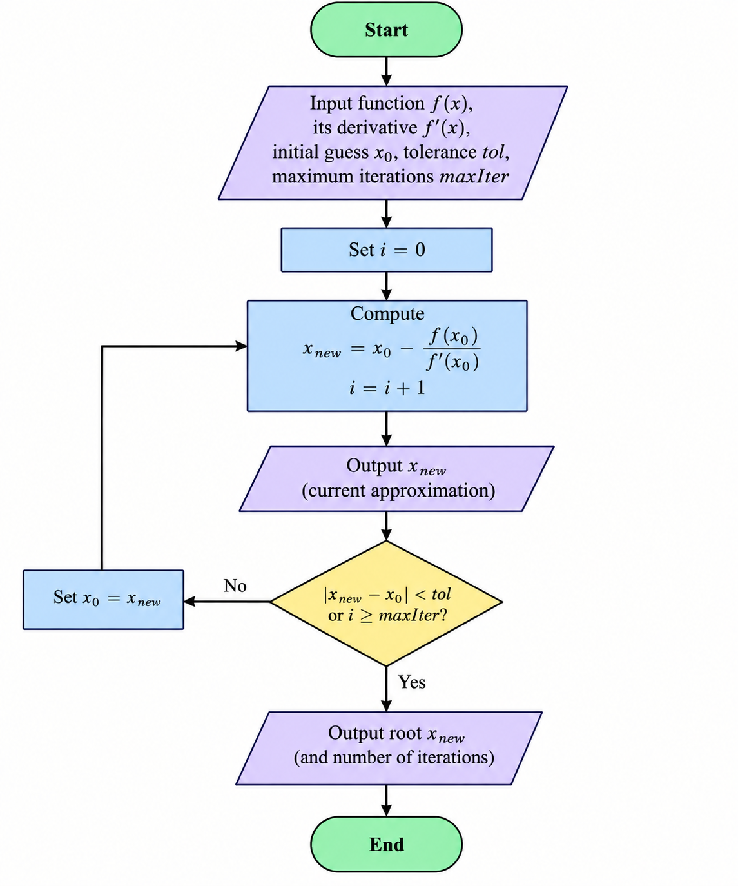
Use Newton’s method to find the zeros of x-f(x)f'x

Slide 2
MATLAB CODES
clc;
clear;
close all;
% Define the function f(x)
f = @(x) x^3 - x - 2;
% Derivative of f(x)
df = @(x) 3*x^2 - 1;
% Initial guess
x0 = 1.5;
% Tolerance
tol = 1e-6;
% Maximum number of iterations
maxIter = 100;

Slide 3
% Newton-Raphson iteration
fprintf('Newton''s Method\n');
fprintf('---------------------------\n');
fprintf('Iteration x\n');
for i = 1:maxIter
% Newton formula
x1 = x0 - f(x0)/df(x0);
fprintf('%5d %.10f\n', i, x1);
% Check convergence
if abs(x1 - x0) < tol
break;
end
x0 = x1;
end

Slide 4
fprintf('\nRoot = %.10f\n', x1);
fprintf('Number of iterations = %d\n', i);
% Plot the function
x = linspace(-3,3,500);
y = f(x);
figure;
plot(x,y,'LineWidth',1.5);
hold on;
% x-axis
plot(x,zeros(size(x)),'k--');

Slide 5
% Root
plot(x1,f(x1),'ro','MarkerSize',8,'LineWidth',2);
grid on;
xlabel('x');
ylabel('f(x)');
title('Newton''s Method');
legend('f(x)','x-axis','Root');

Slide 6
PSEUDO CODES
Define f(x)
Define f'(x)
Input initial guess x0
Input tolerance tol
Input maximum number of iterations N
Set i = 0
REPEAT
Calculate:
x_new = x0 - f(x0) / f'(x0)
Set i = i + 1
Display x_new
IF |x_new - x0| < tol THEN
Display "Root =", x_new

Slide 7
Display "Root =", x_new
Display "Number of iterations =", i
STOP
END IF
Set x0 = x_new
UNTIL i >= N
Display "Maximum number of iterations reached"
Display "Approximate root =", x_new
END

